Slide 1
THREATS TO GLOBAL ENVIRONMENT
Name:
Tutor:
Institution:

Slide 2
ENERGY SOURCES

Slide 3
HISTORY OF ENERGY SOURCES
There has been development of various energy sources throughout the period that has led to the energy consumption pattern.
Wood was the primary source of energy until 1800s.
In 19th Century, coal was adamant which the primary source of electricity.
Petroleum products then took over in the middle of the last century
During 1970, nuclear electric power was developed all the way up to 20th Century.
Notes:
According to the history, energy sources has been the source to most of industrial activities and agricultural activities. Furthermore, most technology depend on the use of energy resources. In fact, the economy of a state is ruled by the price of energy resource. Therefore, energy resources is a fundamental factor to consider in UN assessment as compared to any other factor.

Slide 4
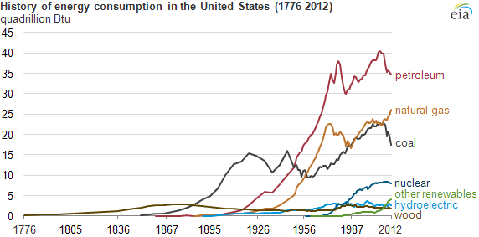
HISTORY OF ENERGY CONSUMPTION
Notes:
From the graph, petroleum is the leading source of energy amongst them all. Along the time period, there are increased rates of energy uses. The graph clearly shows that in change of time,, people are abandoning the traditional sources of energy and improving on it. That translates that, the cost of energy resource is increasing with time and being that the cost of energy is a determinant to the prices of other goods, then it is a critical factor to consider the assessment.

Slide 5
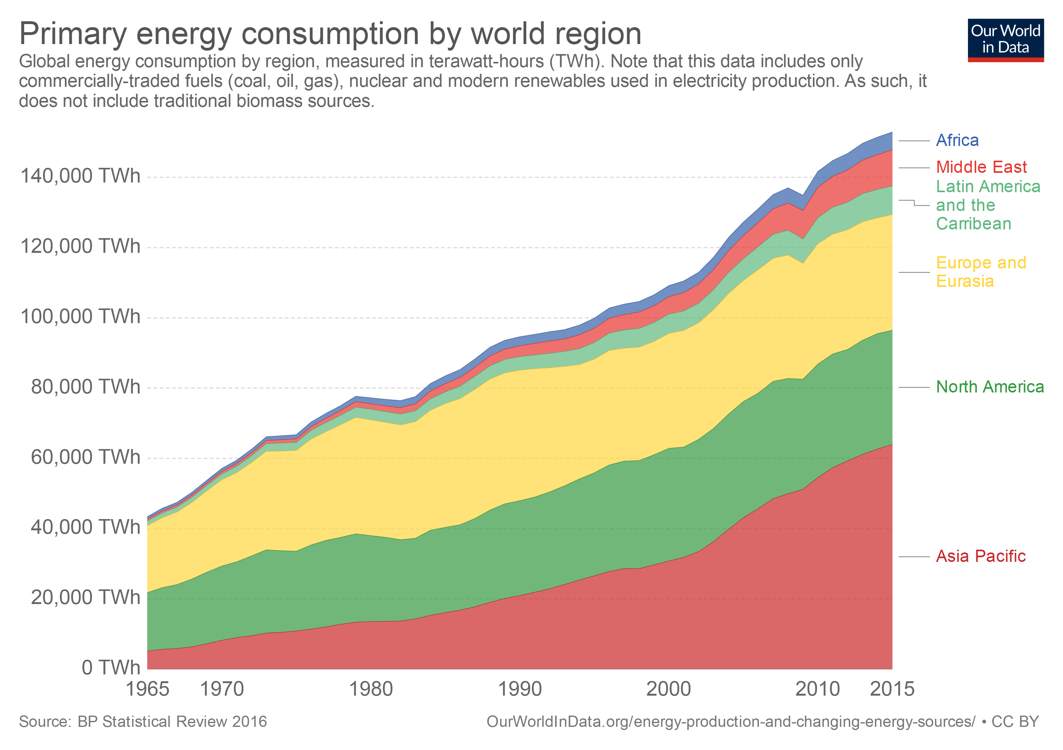
PRIMARY ENERGY CONSUMPTION WORLDWIDE
Notes:
From the graph shows energy consumption across continental regions. The data includes commercial source of energy; gas, oil and coal excluding traditional biofuels. Developing Asia and Africa are the continents who predominantly use traditional biofuels. Europe and Eurasia including North America have lead in energy consumption. However, consumption of energy across other parts of the world has increased dramatically especially in Asia Pacific

Slide 6
THE EFFECTS OF THIS THREAT TO THE WORLD POPULATION
The effects of increased consumption of energy resources lead to;
    Increased carbon footprint
    Reduced supply of energy resources
    A threat to change of climate
    Increased costs of energy
Notes:
The over use of energy consumption has clearly seemed to be a threat in the world wide population. Poor and many developing countries suffer from low capital to afford the increasing cost of energy. Therefore, prioritizing the assessment of energy is a priority in order to beat up the cost of energy that influences the prices of other goods. The UN should therefore prioritize the assessment of energy sources.

Slide 7
CLIMATE CHANGE

Slide 8
HISTORY OF CLIMATE CHANGE
Climate change is the alternations of the weather patterns.
Humans are believed to be capable of changing the weather temperatures by influencing rainfall though irrigating a desert, plowing fields and chopping down trees.
According to the theory of Dust Bowl, rain is believed to follow plow
Initially, the sunlight reaching the planet used to be balanced.
Today, due to radiation due to energy getting back to the atmosphere, there are emission greenhouse gases.
Notes:
Since human been have been known to influence the climate change, there is need to focus on how to improve the climate changes to avoid the hazard that is caused by extreme climate changes. Much of sunlight has been considered harmful to all living organism and plants. Also, radiation has been known to start eating up the planet by drying up all the water sources which are essential for both animals, plants and human beings.

Slide 9
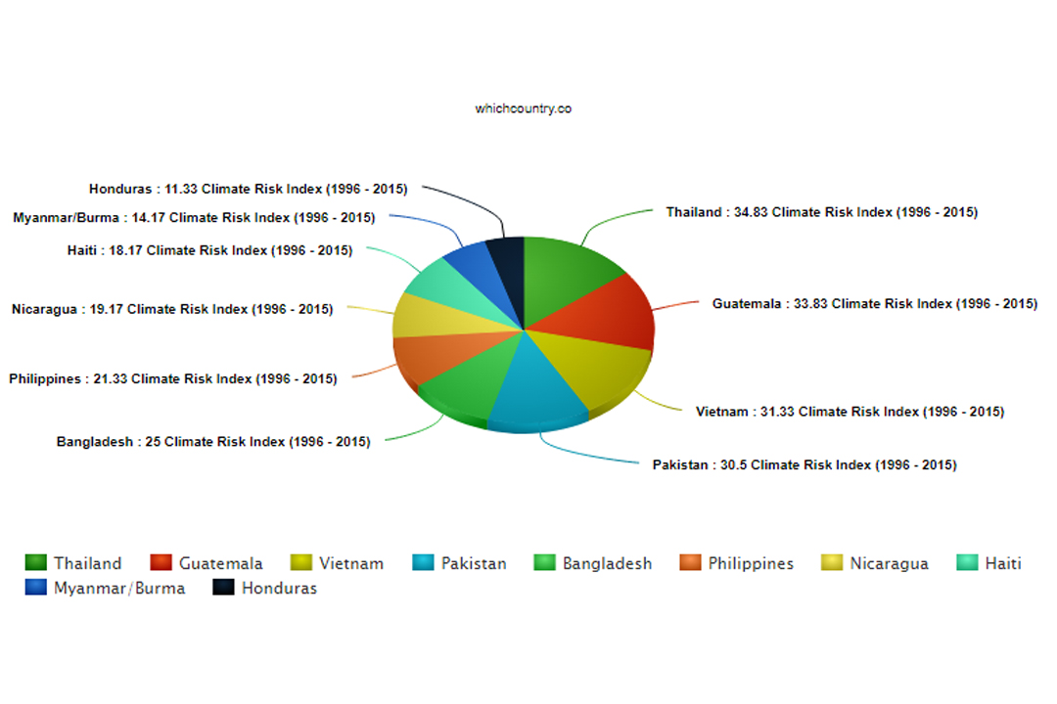
Notes:
Extreme climate changes are seen common in developing countries and other poor countries which are highly populated. From the graph, Thailand, leads in the experiencing extreme temperatures and Honduras is last in the least. This therefore shows the need to take the climate change factor seriously more than any other factor especially since extreme factors could lead to droughts and flooding.

Slide 10
CLIMATE CHANGE WORLDWIDE
Extreme climate changes affect the lives of people
Taking the first ten affected countries affected by extreme weather, Thailand takes the lead while Honduras takes the last position
Thailand contains a climate risk index of 34.83 while Honduras takes 11.33
Most of these countries are poor to afford investing in research and development to improve on climate changes
Notes:
There is need for developing countries to capitalize in technology that reads climate changes in order to under the correct and necessary measure to avoid any unpreparedness to any upcoming hazards that may be influenced by uncontrollable climate conditions. Countries like Thailand, Guatemala and Vietnam that are prone to the extreme climate changes should be considered when making goals to control the factors affecting the global climate.

Slide 11
EFFECTS OF CLIMATE CHANGE
It has caused increased food droughts, famines and severe storms
Crop production has been impossible due to extreme climate change
Has led to deforestation and soil degradation especially in Bangladesh due to increased population
Increased food crises and problems of drinking water
In Haiti, has been prone to Hurricanes which hassled to damage of lives and plants
Notes:
The repercussions that are likely to occur due to extreme changes are so huge such as low crop production, lost of human lives including animals which would be devastating for a country. For the economy to balance and the state to grow, climate change is a major factor to put into inconsideration and look for ways to control it instead of looking for finance to take care of the issues that are caused by extreme climate conditions.

Slide 12
LACK OF EDUCATIONAL OPPORTUNITIES

Slide 13
History
Lack of education opportunities has been greatly influenced by race
White American leads in getting good education while the black Americans rarely gets the opportunity
Two-thirds of students that attends school are from the minority group.
Poverty and marginalization has also been a major factor to lacking education opportunities
Also, increased inequality by history has led to females lacking education
Notes:
Education has been included in the list of basic wants to humans. Good education is considered a fundamental key to getting a good paying and decent job for survival. With increased unemployment rate worldwide, it is crucial to ensure that people are well educated world wide to increase the opportunities of jobs. The goal of each country should be to combat factors like racism that factor out some people in getting education.

Slide 14
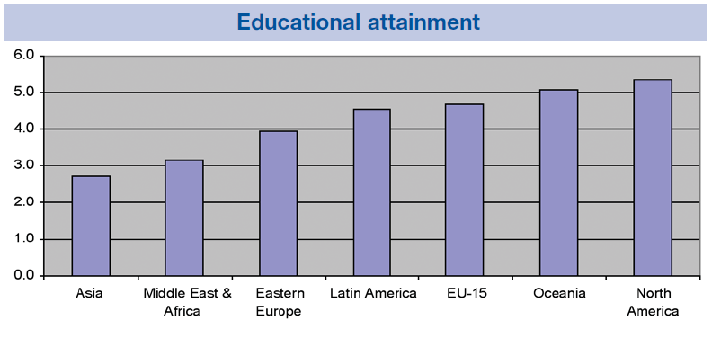
EDUCATIONAL ATTAINMENT WORLDWIDE
Notes:
From the graph, Asia is seen to be the most affected country in term of low educational opportunities followed by Middle East and Africa. On the other hand, north America is seen to lead in terms of getting good education. This translated to the development of that country. When people are economically empowered and have good educational skills, they are like to bring improvement and development in their country.

Slide 15
EFFECTS OF LACK OF EDUCATIONAL OPPORTUNITIES
They lack cultural identity
Poor child welfare system
Poor support networks
High unemployment rates
Lack of survival needs
Remote community
Notes:
The effects of lack of educational opportunities has been seen to cause more to a country. For instance, a country experiencing poor child welfare system means that there is no secure future for the country. Also, poor educational qualifications lead to poverty and lack of essential needs since it would be hard to afford them especially with the increased cost of living world wide.

Slide 16
CIVIL WARS

Slide 17
HISTORY OF CIVIL WARS
In the 19th century, United Stated were in the era of tremendous growth
There was an economic difference between southern and northern regions
Civil war started in 1861 after tensions between Sothern and Northern states in U.S.
The deadliest war ever fought in American soil killed 2.4 million soldiers, millions got brutally injured and south was ruined.
Notes:
Civil wars is one of the greatest factor that should be considered by any state in pursuing their goals. Wars has be proven to cause deaths and unstable economy. The loosing country is said to have lost more for they are made slaves by the winning country and have to operate by the terms of the colonizers. Therefore, the country should prioritize in their goals on how to avoid wars.

Slide 18
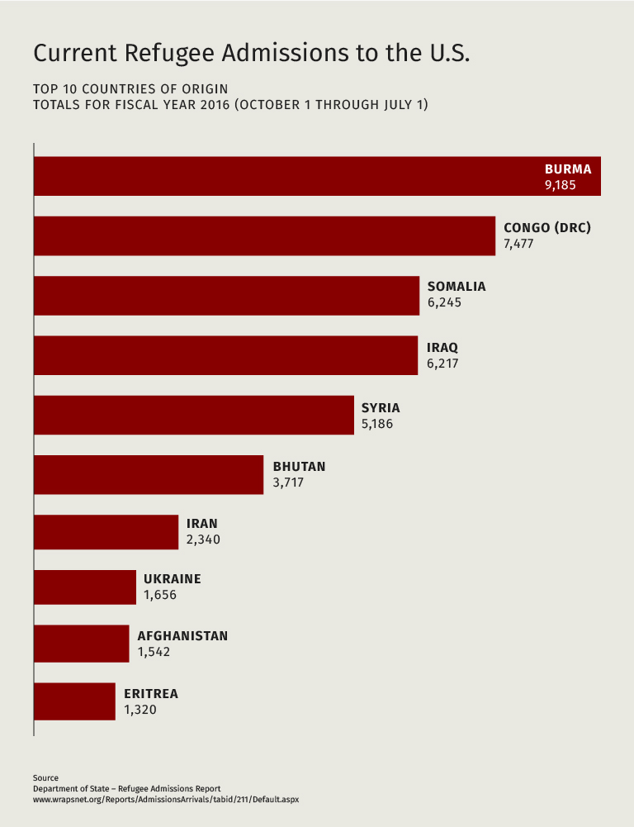
COUNTRIES AFFECTED
Notes:
From the graph, the countries with increased numbers of refugees are the most affected by civil wars. Burma is seen to lead in the list and Eritrea is the least in the list. There are a lot of instabilities that comes from civil wars such as loss of economic activities and homes which people had heavily invested on and getting back to the original position would take more time and more capital.

Slide 19
EFFECTS OF CIVIL WAR
Introduction of slavery
Borrowing of money to stabilize the economy
Many lost lives
Production of weapons
Plantation system was crippled
inflation
Notes:
The effects of civil wars has lead to loss of many lives and crop production. This means that the affected country is in a worse state than it was before the war. Since civil war are mostly caused by ideology indifferences, then there is need for a country to take precaution by ensuring a stable political background and ensure peace with other countries to avoid the cause for a civil war.

Slide 20
REFERENCES
Hannah Ritchie 2017, Energy Production & Changing Energy Sources http://data.worldbank.org/data-catalog/world-development-indicators
Solomon, B.D. and Krishna, K., 2011. The coming sustainable energy transition: History, strategies, and outlook. Energy Policy, 39(11), pp.7422-7431 https://www.eia.gov/todayinenergy/detail.php?id=11951
West, D.M., 2007. Global e-government, 2007. InsidePolitics. https://www.whichcountry.co/top-10-countries-most-affected-by-climate-change/
Fahs, A. and Waugh, J. eds., 2005. The Memory of the Civil War in American Culture. Univ of North Carolina Press. https://books.google.co.ke/books?hl=en&lr=&id=Hd819S4eB3gC&oi=fnd&pg=PP6&dq=civil+war+in+american+memory&ots=Pu1nhKTGyX&sig=Fk9KnWFhC3bWDeCV0jyHNroJX_8&redir_esc=y#v=onepage&q=civil%20war%20in%20american%20memory&f=false
Blight, D.W., 2002. Beyond the battlefield: race, memory & the American Civil War. Univ of Massachusetts Press. https://books.google.co.ke/books?hl=en&lr=&id=B0g9dC_QxMQC&oi=fnd&pg=PP11&dq=civil+war+in+american+memory&ots=2vcUQsp8RW&sig=skExoLlBDgrO83u_76oqMxzhQDI&redir_esc=y#v=onepage&q=civil%20war%20in%20american%20memory&f=false

